Slide 1
Props, State, React Hooks, and Event Handling
By Prof. Soleha. A. Sayyed

Slide 2

Props in React
In React, props (short form for "properties") are used to pass information from one component to another.
The main purpose of props is to allow a parent component to send data to its child components.
Props cannot be modified by the receiving component.
They are strictly for reading data and should not be altered.
Props can be updated when the parent component’s state changes.
Example:
import React from 'react';
function Greet(props) {
return <h1>Hello, {props.name}!</h1>;
}
function App() {
return <Greet name="John" />; }
export default App;
Output:

Slide 3
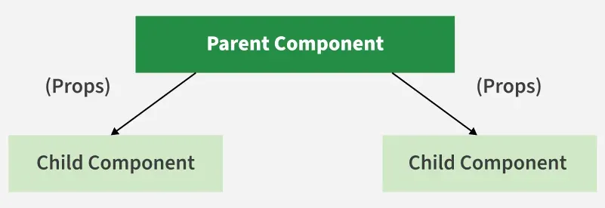
Working of Props in React
Props in React allow data to flow from a parent component to a child component, making components dynamic and reusable.
Steps to use Props:
Define an attribute and its value (data).
Pass it to the child component by using props.
Render the props data.

Slide 4

Example:
Parent.js
import React from 'react';
import Child from './Child';
function Parent() {
return (
<div>
<h1>Welcome to the Parent Component!</h1>
<Child name="John" /> {/* Passing the 'name' prop with value "John" */}
</div>
);
}
export default Parent;
App.js
import React from 'react';
import Parent from './Parent';
function App() {
return (
<div>
<Parent /> {/* Render the Parent component */}
</div>
);
}
export default App;
Child.js
import React from 'react';
function Child(props) {
return <h2>Hello, {props.name}!</h2>;
}
export default Child;

Slide 5

Passing Multiple Props
In React, a parent component can pass multiple props to a child component, where each prop may hold a different type of data such as text, numbers, arrays, or functions.
import React from 'react';
import Child from './Child';
function Parent() {
const parentStyle = {
textAlign: 'center',
};
return (
<div style={parentStyle}>
<h1>Welcome to the Parent Component!</h1>
<Child name="John" age={25} city="New York" />
</div>
); }
export default Parent;
import React from 'react';
function Child(props) {
const childStyle = {
marginTop: '20px',
fontSize: '18px',
color: '#333',
};
return (
<div style={childStyle}>
<h2>Hello, {props.name}!</h2>
<p>You are {props.age} years old.</p>
<p>You live in {props.city}.</p>
</div>
); }
export default Child;
import React from 'react';
import Parent from './Parent';
function App() {
const appStyle = {
display: 'flex',
justifyContent: 'center',
alignItems: 'center',
height: '100vh',
margin: 0,
fontFamily: 'Arial, sans-serif',};
return (
<div style={appStyle}>
<Parent />
</div>
); }
export default App;

Slide 6
Passing Functions as Props
Props can also be used to pass functions from a parent component to a child component, allowing the child to interact with the parent’s logic.
import React from 'react';
import Parent from './Parent';
function App() {
return (
<div>
<Parent />
</div>
);
}
export default App;
import React from 'react';
import Child from './Child';
function Parent() {
const handleClick = () => {
alert('Button clicked in Child!');
};
return <Child onClick={handleClick} />;
}
export default Parent;
import React from 'react';
function Child(props) {
return <button onClick={props.onClick}>Click Me!</button>;
}
export default Child;

Slide 7

How to Set a Default Value for Props
In React, default props are a feature that lets us set default values for props. This is useful when no value is passed for a prop, ensuring the component still works with a fallback value.
import React from 'react';
import Greeting from './Greeting';
function App() {
return (
<div>
<Greeting />
<Greeting name="Alia" />
</div>
);
}
export default App;
import React from 'react';
function Greeting(props) {
return <h1>Hello, {props.name}!</h1>;
}
Greeting.defaultProps = {
name: 'Guest',
};
export default Greeting;

Slide 8
Data Flow in React JS:
React follows a unidirectional data flow, meaning that data flows in a single direction through the components.
This helps in maintaining a predictable state and making it easier to understand how changes affect the application.
In React, we can pass props from a parent component to a child, and with the help of a callback can also pass props from a child to a parent.
1. Parent to Child:
Data is passed from parent components to child components through props.
The parent component owns the state, and it passes down relevant data to its child components as props.
Props (short for "properties") in React are a mechanism for passing data from a parent component to its child component as a set of read-only attributes.
For example: Sending the data from parent to child as "Hello, this is data from the parent to child".

Slide 9

Example:
// Parent component
import React, { useState } from 'react';
import ChildComponent from './ChildComponent';
function ParentComponent() {
const [data, setData] = useState('"Hello, this is the data from the parent to child".!');
// passing the data to child as props
return <ChildComponent data={data} />;
}
export default ParentComponent;
// Child component
import React from 'react';
// the child is receiving the data as props
function ChildComponent(props) {
return <p>{props.data}</p>;
}
export default ChildComponent;

Slide 10
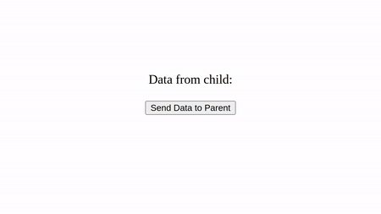
2. Child to Parent:
To communicate from child to parent, the parent can pass down a callback function as a prop to the child.
The child can then invoke this function to send data back to the parent.
Example: Sending the data from child to parent as "Hello, this is data from the child to parent".
// Parent component
import React, { useState } from 'react';
import ChildComponent from './ChildComponent';
function ParentComponent() {
const [data, setData] = useState('"Hello, this is the data from the parent to child".!');
// passing the data to child as props
return <ChildComponent data={data} />; }
export default ParentComponent;
// Child component
import React from "react";
function ChildComponent(props) {
const sendData = () => {
props.sendDataToParent("Hello from child!");
};
return <button onClick={sendData}>Send Data to Parent</button>;
}
export default ChildComponent;

Slide 11
State and Its Management
It is the way an application stores, updates, and shares data between components so the UI stays consistent and responsive.
It helps React apps handle everything from simple form values to larger application-wide data without making the code hard to manage.
Keeps component data organized and easier to control
Makes it simpler to share values across multiple parts of the app
Helps update the UI automatically when data changes.
State Management Techniques
1. Using Hooks
React Hooks provide a built-in way to manage state in functional components.
For simple state, useState is enough, while useReducer is better for more complex state logic.
useState: Used for managing simple local state such as form inputs, toggles, counters, and UI updates.
useReducer: Used for complex state logic involving multiple state values, state transitions, or actions that depend on previous state.

Slide 12
2. UsingContext API
The Context API is a feature built into React that allows for global state management.
It is useful when we need to share state across many components without having to pass props down through multiple levels of the component tree.
3. Using Redux
Redux is a state-management library used in JavaScript apps. It simply manages the state of your application, or in other words, it is used to manage the data of the application. It is used with a library like React. It makes it easier to manage state and data. As the complexity of our application increases.
Redux works using these main concepts:
Store: The central place where all the app’s state is stored.
Actions: Functions that describe changes to be made to the state.
Reducers: Functions that handle actions and update the state based on them

Slide 13
Comparison of Hooks, Context API, and Redux
Hooks | Context API | Redux
Local state management in a component | Shared state across many components | Centralized state management in large apps
Simple and easy to use | Simple but can become complex with large apps | More complex but powerful
Optimized for local state | Good for medium-sized apps, can cause performance issues in large apps | Optimized for large apps with middleware
Single component state | Passing data across deep component trees | Large-scale apps with many components needing to share state
Inside the component | Global but only for specific contexts | Global store accessible from any component

Slide 14
Introduction to Hooks:
React Hooks are functions that allow you to use state and other React features without writing a class.
Before Hooks, stateful logic in React components was primarily encapsulated in class components using the setState method.
Hooks provide a more functional approach to state management and enable the use of lifecycle methods, context, and other React features in functional components.
Why React Hooks?
Simplified Logic: Hooks eliminate the need for class components, reducing boilerplate code and making components easier to understand and maintain.
Reusability: With Hooks, you can extract stateful logic into custom hooks and reuse it across multiple components, promoting code reuse and modularity.
Improved Performance: Hooks optimize the rendering process by allowing React to memorize the state and only re-render components when necessary.
Better Testing: Functional components with Hooks are easier to test compared to class components, as they are purely based on input and output.

Slide 15
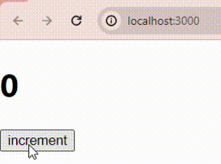
UseState
It manages state in functional components by providing a state variable and a function to update it, enabling dynamic UI updates.
Syntax:
const [stateVariable, setStateFunction] = useState(initialStateValue)
Example:
import React from 'react'
import {useState} from 'react';
export default function Incrementor() {
const [count,setCount]=useState(0);
const increment=()=>{ setCount(count+1); }
return ( <div>
<h1>{count}</h1>
<button onClick={increment}>increment</button>
</> ) }

Slide 16
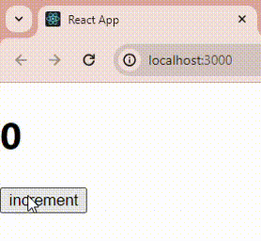
useEffect :
It handles side effects like data fetching, subscriptions, or DOM manipulation in functional components after rendering.
Syntax:
useEffect(() => { return () => { };}, [dependencies]);
Example:
import React from "react";
import { useState, useEffect } from "react";
export default function Incrementor() {
const [count, setCount] = useState(0);
useEffect(() => {
document.title = `Count incremented to ${count}`;
});
const increment = () => { setCount(count + 1);
};
return ( <div> <h1>{count} </h1> <button onClick={increment}>increment</button> <div/> ); }

Slide 17
Rules of React Hooks
Hooks should be called only at the top level.
Don't call hooks conditionally or inside a loop.
Hooks should be called only in a functional component, not through regular JavaScript functions.
Custom Hooks
Custom Hooks in React allow you to create your own hook and help you to reuse that hook's functionality across various functional components. A custom hook can be created by naming a JavaScript function with the prefix "use".
Syntax :
function useCustomHook() {
//code to be executed
}

Slide 18
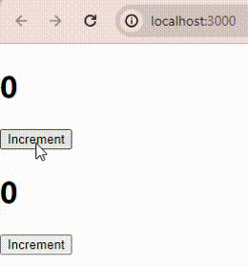
Example:
//useCustomHook.js
import { useState} from "react";
export function useCustomHook(value) {
const [count,setCount]=useState(value);
const increment = () => {
setCount(count + 1);
};
return{
count,
increment,
};
};
// FirstComponent.js
import {useCustomHook} from "./useCustomHook";
export default function FirstComponent(){
const {count,increment} = useCustomHook(0);
return (
<>
<h1>{count}</h1>
<button onClick={increment}>Increment</button>
</>
);
};
// SecondComponent.js
import {useCustomHook} from "./useCustomHook";
export default function SecondComponent(){
const {count,increment} = useCustomHook(0);
return (
<>
<h1>{count}</h1>
<button onClick={increment}>Increment</button>
</>
);
};

Slide 19
Event Handling in React JS:
Event Handling in React is the process of responding to user actions such as clicking a button, typing in a textbox, submitting a form, or moving the mouse.
React uses Synthetic Events, which provide a consistent way to handle events across all browsers.
Features
Event names are written in camelCase (e.g., onClick, onChange).
Event handlers are passed as functions, not strings.
React uses SyntheticEvent objects for better cross-browser compatibility.
Example:
function App() {
const handleClick = () => {
alert("Button Clicked!");
};
return <button onClick={handleClick}>Click Me</button>;
}
export default App;

Slide 20
Common React Events
onClick – Triggered when an element is clicked.
onChange – Triggered when the value of an input field changes.
onSubmit – Triggered when a form is submitted.
onKeyDown – Triggered when a key is pressed.
onMouseOver – Triggered when the mouse pointer moves over an element.
onFocus – Triggered when an element receives focus.
onBlur – Triggered when an element loses focus.
Advantages
Easy to handle user interactions.
Provides consistent behavior across different browsers.
Integrates seamlessly with React state for dynamic UI updates.
Makes applications more interactive and responsive.

Slide 21
Conditional Rendering in React JS
Conditional Rendering in React is the technique of displaying different UI elements or components based on a condition.
It allows you to control what is shown to the user depending on the application's state or data.
Common Ways to Perform Conditional Rendering
Using if...else Statement : Used when multiple conditions need to be checked.
Using Ternary Operator (condition ? true : false) : Best for simple if-else conditions inside JSX.
Using Logical AND (&&) Operator : Displays an element only if the condition is true.
Using Conditional Variables : Store JSX in a variable and render it based on a condition.

Slide 22
Example:
function App() {
const isLoggedIn = true;
return (
<div>
{isLoggedIn ? <h2>Welcome User!</h2> : <h2>Please Login</h2>}
</div>
);
}
export default App;
Advantages
Makes the UI dynamic and interactive.
Displays content based on user actions or application state.
Improves code readability and maintainability.
Reduces unnecessary rendering of components.

Slide 23
Lists and Keys:
Lists in React are used to display multiple items by rendering an array of data. The map() function is commonly used to create a list of JSX elements.
Keys are unique identifiers assigned to each list item. They help React identify which items have changed, been added, or removed, improving rendering
performance.
Example:
function App() {
const fruits = ["Apple", "Banana", "Mango"];
return ( <ul>
{fruits.map((fruit, index) => (
<li key={index}>{fruit}</li>
))}
</ul> ); }
export default App;

Slide 24
Why are Keys Important?
Identify each list item uniquely.
Help React update the UI efficiently.
Improve rendering performance.
Prevent unnecessary re-rendering of components.
Advantages
Makes it easy to render dynamic data.
Reduces repetitive code.
Improves application performance.
Simplifies updating and managing lists.

